Slide 1

ESSENTIAL MEDICINE
BY
DR.G.AARTHIPRIYANKA
POST GRADUATE
DEPARTMENT OF PHARMACOLOGY

Slide 2

Accessibility to medicines is too the fundamental right of every person.
WHO introduced the concept of essential medicines (EM) in 1977.
WHO defined essential medicines as those that satisfy the priority health care needs of the population.

Slide 3

EM are intended to be available within the context of functioning health systems at all times and in adequate amounts, in a appropriate dosage forms, with assured quality & adequate information, & at a price the individual & the community can afford.
EM list needs to be country specific addressing the disease burden of the nation.

Slide 4
To guide the member countries, The WHO brought its first model list of essential medicines in the year 1977 which contained 186 medicines along with the dosage forms & strength.
This has been updated once in 2 years.
The current version is the 22nd list published in 2021 which contain 479 medicines.
The 8th WHO EML for children (EMLc) was updated in Sep 2021

Slide 5
WHO Electronic EML
eEML is a comprehensive, freely accessible, online database containing information on EM

Slide 6
WHO Global EML
Database of EML for 137 countries based on WHO’s National Essential Medicines lists repository

Slide 7
MOHFW, Government of India released the first national list of essential medicines (NLEM) in 1996 consisting of 279 Medicines.
The latest list was published in 2015 containing 376 medicines

Slide 8
CRITERIA FOR INCLUSION OF A MEDICINE IN NLEM ARE AS FOLLOWS:
Approved/licensed in India.
Useful in disease which is a public health problem in India
Proven and safety profile based on valid scientific evidence
Cost effective
Aligned with the current treatment guidelines for the disease
Stable under the storage conditions in India

Slide 9
When More Than One Medicine Are Available From The Same Therapeutic Class, Preferably One Prototype/ Medically Best Suited Medicine Of That Class To Be Included After Due Deliberation And Careful Evaluation Of Their Relative Safety, Efficacy, Cost-Effectiveness.
Price Of Total Treatment To Be Considered And Not The Unit Price Of A Medicine.

Slide 10
Fixed Dose Combinations (Fdcs) Are Generally Not Included Unless The Combination Has Unequivocally Proven Advantage Over Individual Ingredients Administered Separately, In Terms Of Increasing Efficacy, Reducing Adverse Effects And/Or Improving Compliance.
The Listing Of Medicine In NLEM Is Based According To The Level Of Health Care, I.E. Primary (P), Secondary (S) And Tertiary (T) Because The Treatment Facilities, Training, Experience And Availability Of Health Care Personnel Differ At These Levels.

Slide 11
The Criteria For Deletion Of A Medicine From NLEM Is As Follows: –
The Medicine Has Been Banned In India.
There Are Reports Of Concerns On The Safety Profile Of A Medicine.
A Medicine With Better Efficacy Or Favorable Safety Profiles And Better Cost-Effectiveness Is Now Available.
The Disease Burden For Which A Medicine Is Indicated Is No Longer A National Health Concern In India.
In Case Of Antimicrobials, If The Resistance Pattern Has Rendered A Medicine Ineffective In Indian Context.

Slide 12
The NLEM Can:
1) Guide Safe And Effective Treatment Of Priority Disease Conditions Of A Population .
2) Promote The Rational Use Of Medicines.
3) Optimize The Available Health Resources Of A Country .
4) It Can Also Be A Guiding Document For:
State Governments To Prepare Their List Of Essential Medicines.
Procurement And Supply Of Medicines In The Public Sector.
Reimbursement Of Cost Of Medicines By Organizations To Its Employees .
Reimbursement By Insurance Companies.
Identifying The ‘MUST KNOW’ Domain For The Teaching And Training Of Health Care Professionals.

Slide 13
21st EDITION OF WHO MODEL LIST OF ESSENTIAL MEDICINES ( 2019 )
Medicines Are Categorized Into Various Sections Based On Therapeutic Application. Therefore It Is Possible That A Medicine With More Than One Indication Appears In More Than One Category.
Medicines Are Given In Generic Names With Their Formulation & Strength.
Medicines & Dosage Forms Are Listed In Alphabetical Order.

Slide 14
The Core List
Presents A List Of Minimum Medicine Needs For A Basic Health-Care System, Listing The Most Efficacious, Safe And Cost–Effective Medicines For Priority Conditions.

Slide 15
The [C] Symbol In Core List:
Placed Next To An Individual Medicine Or Strength Of Medicine On The Core List Signifies That There Is A Specific Indication For Restricting Its Use To Children.

Slide 16
The Complementary List
Presents A List Of Essential Medicines For Priority Diseases, For Which Specialized Diagnostic Or Monitoring Facilities, And/Or Specialist Medical Care, And/Or Specialist Training AreNeeded.

Slide 17
The [C] Symbol In Complimentary List:
Placed Next To An Individual Medicine Or Strength Of Medicine On The Complementary List. Signifies That The Medicine(S) Require(S) Specialist Diagnostic Or Monitoring Facilities, And/Or Specialist Medical Care, And/Or Specialist Training For Their Use In Children.

Slide 18
The Square Box Symbol ( )
Intended To Indicate Clinical Performance Within A Pharmacological Class .

Slide 19
The ( a) Symbol
Indicates That There Is An Age Or Weight Restriction On Use Of The Medicine.

Slide 20
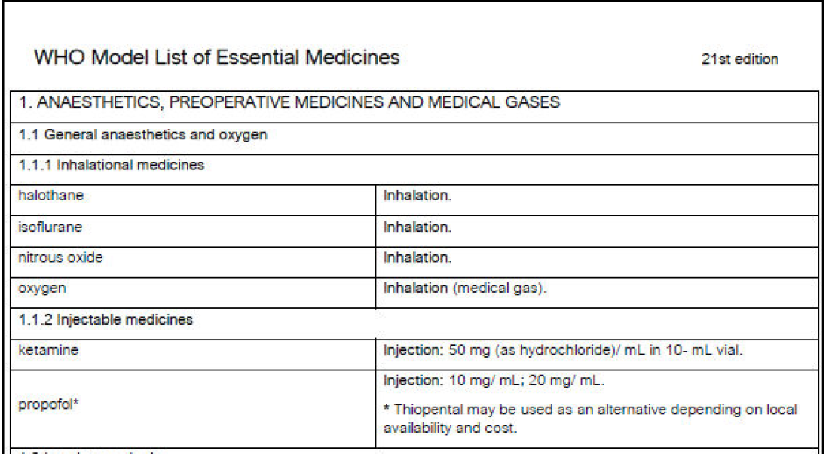

Slide 21
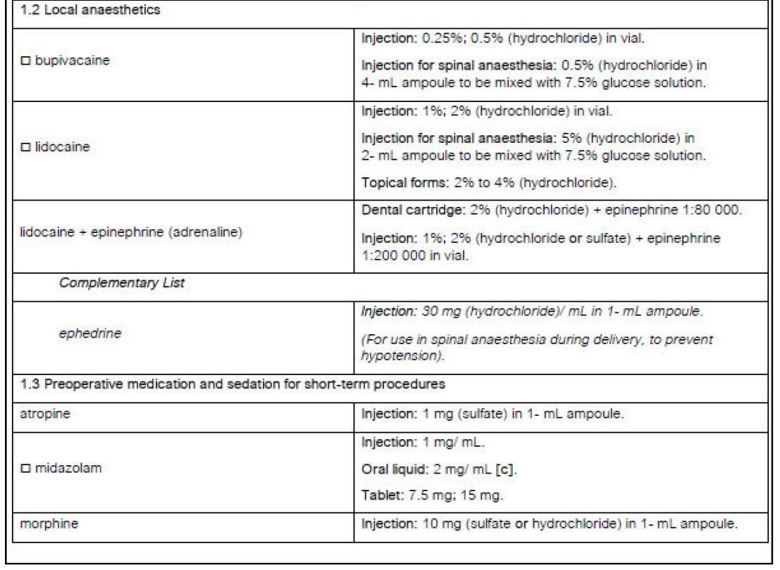

Slide 22
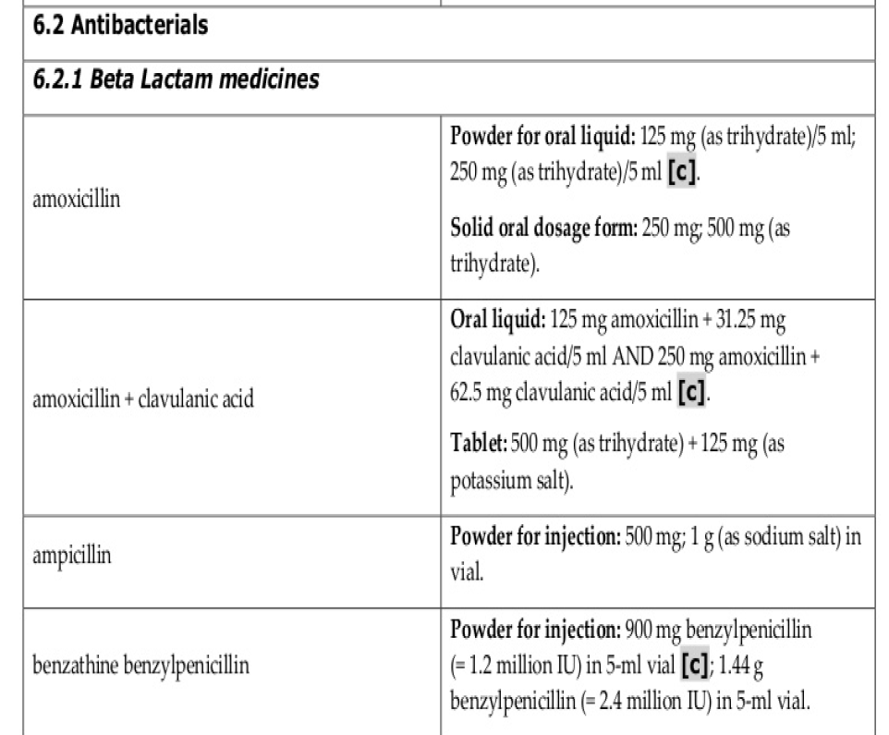

Slide 23
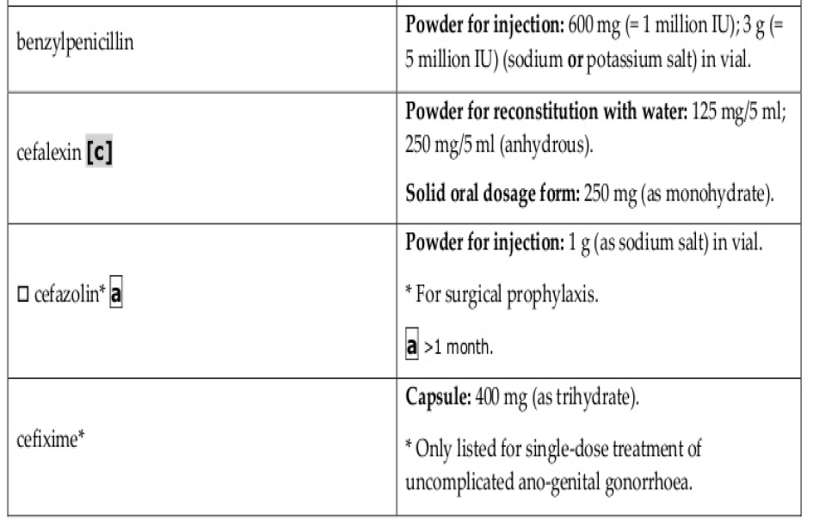

Slide 24
MODEL NLEM 2015
The Listing Of Medicine In NLEM Is Based According To The Level Of Health Care, i.e., Primary (P), Secondary (S) And Tertiary (T) Because The Treatment Facilities, Training, Experience And Availability Of Health Care Personnel Differ At These Levels. Out Of Total 376 Medicines ,209 Medicines Listed For All Levels Of Health Care (P,S,T ), 115 Medicine For Secondary & Tertiary Levels (S,T ) And 79 Medicines Are Listed For Tertiary Level ( T ) Only.
The Medicines Are Categorized Into Various Sections Based On Therapeutic Application.
Medicines Are Given In Generic Forms With Their Formulation & Strength.
Medicines Are Listed In Alphabetical Order Under Each Category.

Slide 25
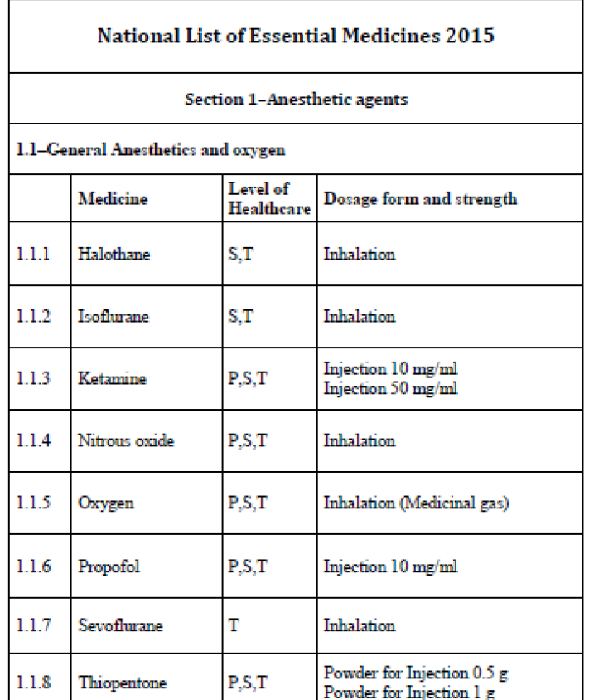

Slide 26
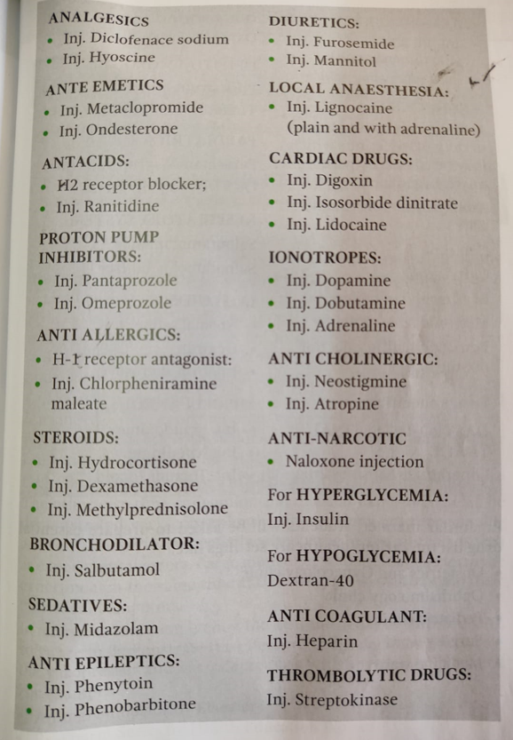

Slide 27
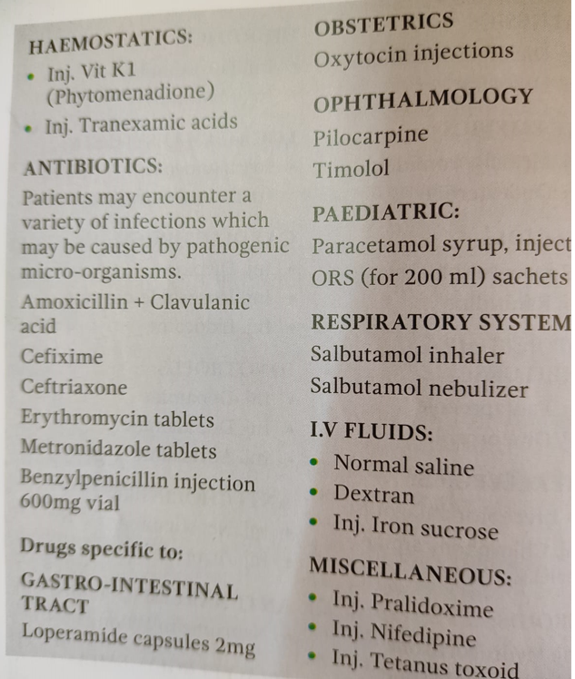

Slide 28
GROUP DIVISION – A BATCH
ROLL NO 1 – 25, GROUP LEADER ROLL NO – 1,DEPT. OF MEDICINE & PSYCHIATRY
ROLL NO 26 – 50, GROUP LEADER ROLL NO – 26,DEPT. OF DERMATOLOGY
ROLL NO 51 – 75, GROUP LEADER ROLL NO – 51,DEPT. OF PAEDIATRICS

Slide 29
GROUP DIVISION – B BATCH
ROLL NO 76 – 100, GROUP LEADER ROLL NO – 76,DEPT. OF ANESTHESIA
ROLL NO 101 – 125, GROUP LEADER ROLL NO – 101,DEPT. OF SURGERY & ORTHOPAEDICS
ROLL NO 126 – 150, GROUP LEADER ROLL NO – 126,DEPT. OF OBS & GYN

Slide 30
PREPARE AN ESSENTIAL DRUG LIST FROM THE DEPARTMENT OF MEDICINE & PSYCHIATRY
ANTI-HYPERTENSIVE DRUGS
ANTI-ANGINAL DRUGS
DIURETICS
ANTI-ARRYTHMIC DRUGS
ANTI-MICROBIAL DRUGS
ANALGESICS
ANTI-PROTOZOAL DRUGS
ANTI-DIABETIC DRUGS
ANTI-ASTHMATICS
CORTICOSTEROIDS
ANTI-DEPRESSANTS
ANTI-PSYCHOTICS
MISCELLANEOUS DRUGS
DOSAGE FORM
GENERIC NAME

Slide 31
PREPARE AN ESSENTIAL DRUG LIST FROM THE DEPARTMENT OF DERMATOLOGY
ANTI-FUNGAL AGENTS
CORTICOSTEROIDS
DRUGS IN PSORIASIS
DRUGS IN ACNE
DRUGS IN DERMATOPHYTES
DRUGS IN SCABIES
DRUGS IN IMPETIGO
DRUGS IN DERMATITIS (ATOPIC,SEBORRHIC etc)
DRUGS IN LEPROSY
MISCELLANEOUS DRUGS
DOSAGE FORM
GENERIC NAME

Slide 32
PREPARE AN ESSENTIAL DRUG LIST FROM THE DEPARTMENT OF PAEDIATRICS
ANTI-MICROBIALS
ANTI-EPILEPTICS
ANTI-ASTHMATICS
ANALGESIC/ANTI-PYRETIC
ANTI-DIARRHOEAL
ANTIHELMINTICS
ANTI-TUBERCULOUS
RHEUMATIC HEART DISEASE DRUGS
SCORPION BITE DRUGS
CORTICOSTEROIDS
VITAMINS & MINERALS
MISCELLANEOUS DRUGS
DOSAGE FORM
GENERIC NAME

Slide 33
PREPARE AN ESSENTIAL DRUG LIST FROM THE DEPARTMENT OF ANAESTHESIA
GENERAL ANESTHETICS
LOCAL ANESTHETICS
ADRENERGICS
ANTI-ARRTHYMIC DRUGS
OPIOIDS
BENZODIAZEPINES
ANTI-EMETICS
ANTI-CHOLINERGICS
IV FLUIDS
PROTON PUMP INHIBITORS
MISCELLANEOUS DRUGS
DOSAGE FORM
GENERIC NAME

Slide 34
PREPARE AN ESSENTIAL DRUG LIST FROM THE DEPARTMENT OF SURGERY & ORTHOPAEDICS
ANTI-MICROBIAL DRUGS
OPIOIDS
NSAIDS
ANTI-DIABETICS
ANTI-HYPERTENSIVES
IV FLUIDS
LAXATIVES
ANTI-EMETICS
PROTON PUMP INHIBITORS
CORTICOSTEROIDS
MISCELLANEOUS DRUGS
DOSAGE FORM
GENERIC NAME

Slide 35
PREPARE AN ESSENTIAL DRUG LIST FROM THE DEPARTMENT OF OBSTRETICS & GYNAECOLOGY
TOCOLYTICS
ANTI-MICROBIAL DRUGS
ANTI-FUNGAL DRUGS
CONTRACEPTIVES
ANTI-ANEMIC DRUGS
ANTI-HYPERTENSIVE DRUGS
ANTI-DIABETIC DRUGS
THYROID & ANTI-THYROID DRUGS
ANTI-EPILEPTICS
NSAIDS
ANTI-FIBRINOLYTICS
CALCIUM/VITAMIN D/FOLIC ACID
MISCELLANEOUS DRUGS
DOSAGE FORM
GENERIC NAME

Slide 36
THANK YOU ALL

